Slide 1
Mobile Health Care Application
Subject: ENSE 885as, "Topics in Computer-Supported Collaborative Work
Instructor Name: Timothy Macing
Presented by: Reema Jiyani

Slide 2

Selection of UN goals & Why
In my Mental Health Care application, I decide to focus on below
two goal for Sustainable development:
Goal 3: Ensure healthy lives and promote well-being for all at all ages
Goal 17: Revitalize the global partnership for sustainable development
Why
Natural reaction of community because of covid-19
Drastic shifts in our everyday lives
Withdrawal from routine activities and relationships
Complete disengagement or significant decline in performance at school (or work)
Emotional and physical wellbeing

Slide 3
Findings & Impact of problem
Problem Statement:
Common problem of mental issues
Lack of resources and guidance
Mental disorders are disabling and can affect all aspects of life:
Physical health
Parenting
Work
Finances
Care giving
Relationships with family and friends
Common daily activities

Slide 4
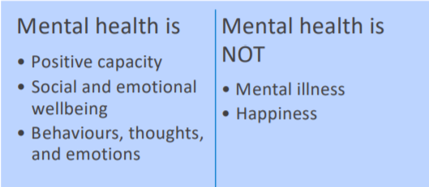
Focus Area
Focus Area & Solution:
Common platform for community (Mental Health Care Application)
User-friendly Design
Positive Experience (Positive Relationships and Connection through tools)
Research and discuss the potential of some basic tools with members
Take care of mis/dis information

Slide 5
Process of researching and gathering requirements
For gathering information I am following online & offline method:
Online:
books, articles, latest concerns about growing need of mental health services
Offline:
Meeting with community
Questionnaires
Surveys

Slide 6
Things I captured in all document
Community characteristics orientation: Find about community life cycle, technology aspiration, community orientation
Technology configuration inventory: Able to make tools and platform list for my application
Drafting an emerging picture: I can able to make emerge picture of my application by achieving integration and balancing polarities
Business Case: In this document I work on business need, cost-benefit analysis, recommendation
Stakeholder Analysis: Decide customer, their interest, power, level of support
Project Scope Statement: WBS (Work breakdown structure) to manage project
Project Requirements: Functional requirement and Technical requirement
Activity-Based Schedule: Includes all the activities in detail

Slide 7
Thank you & Any Questions

